Slide 1
Generics and more
Java Advanced
Spring 2016

Slide 2
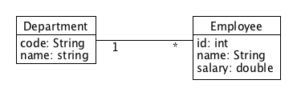
Generics – the problem

Slide 3
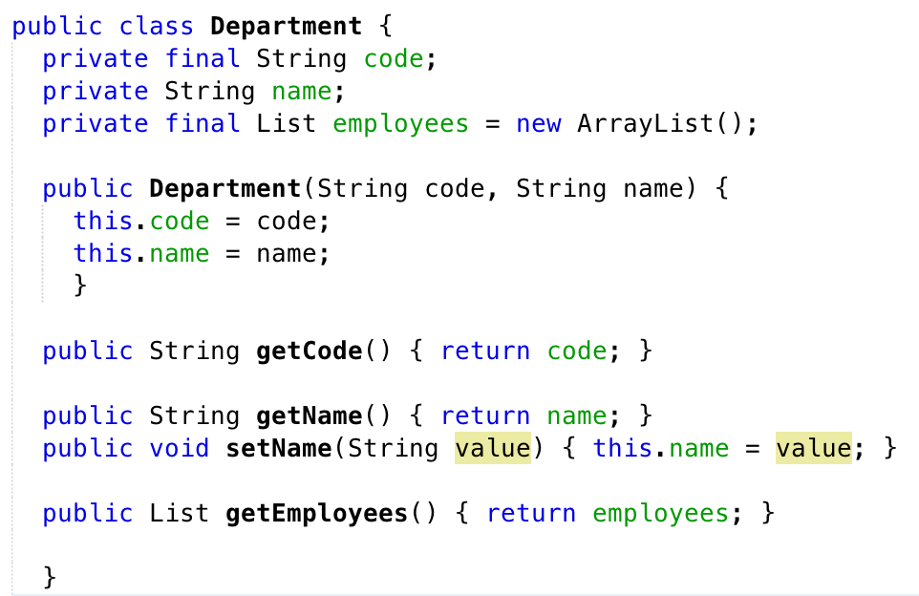
The Department

Slide 4
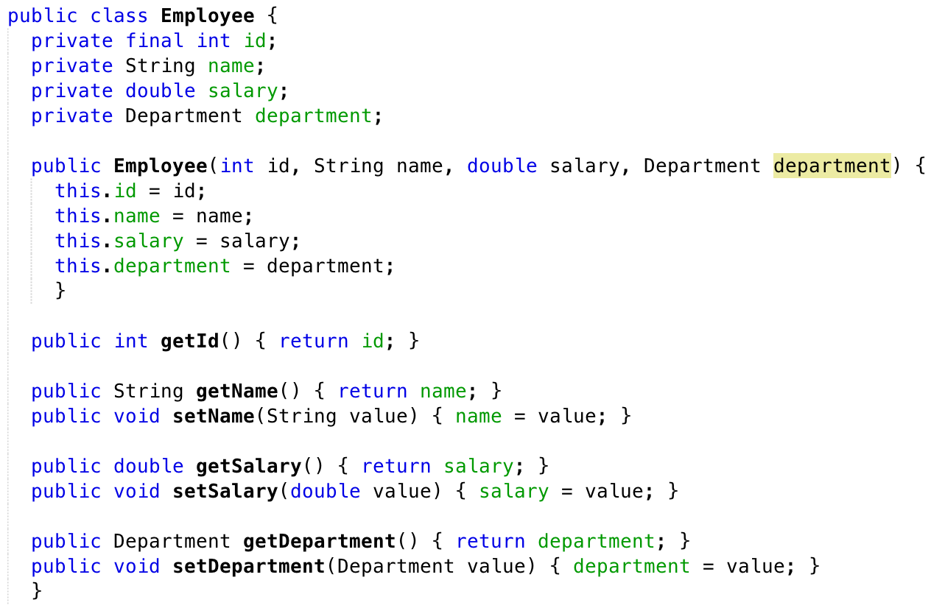
The Employee

Slide 5
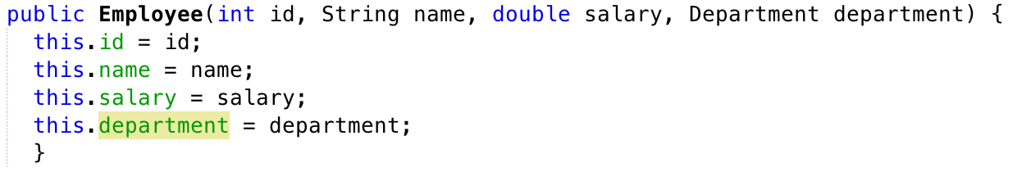
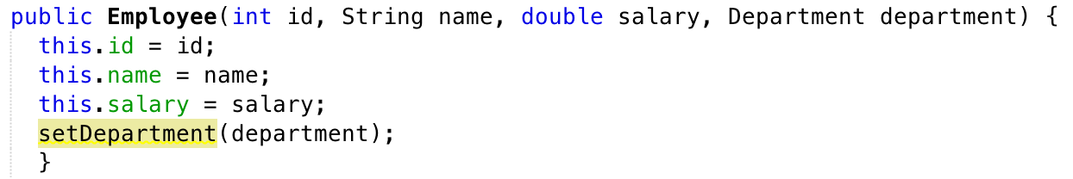
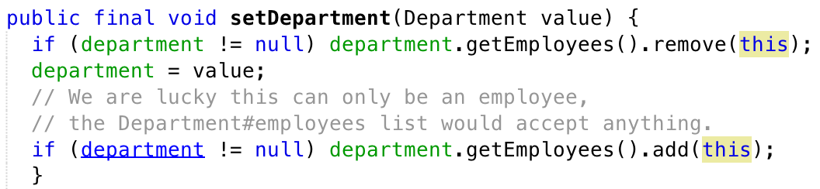
How about the association?

Slide 6
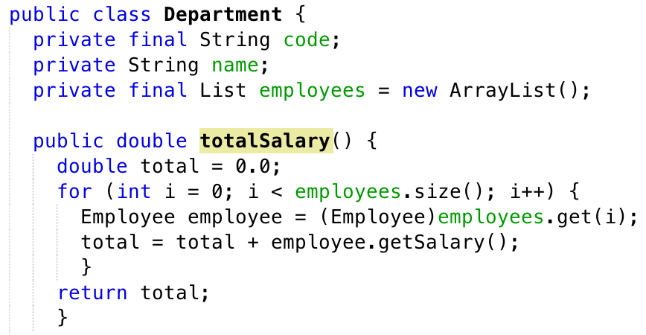
Let’s try to use the collection
What if someone by accident hired a Pet …?

Slide 7
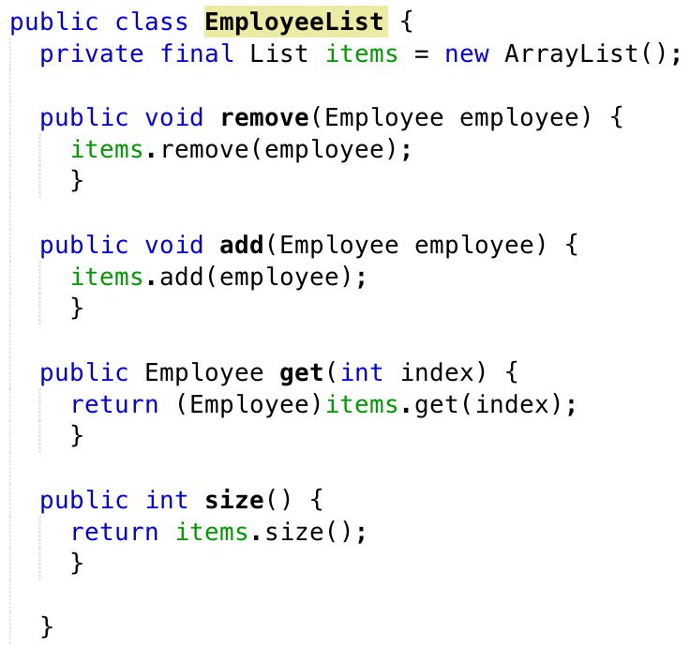
Encapsulation never hurts

